Slide 1

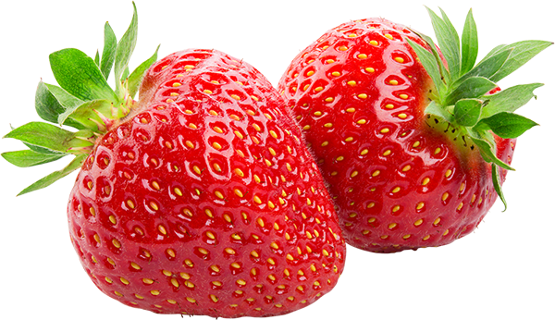
Molecular Nutrition
Work in Progress 3
Radhika Patel and Reilly Cashmore
8/10/2017

Slide 2
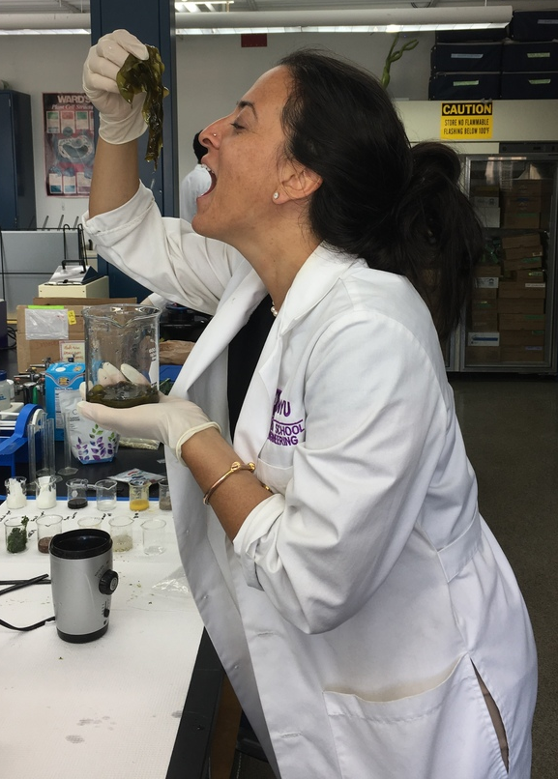
Overview
Objective
Background Information
Experiments
Test Results/ Conclusions
Difficulties
Improvements
Upcoming Tasks

Slide 3
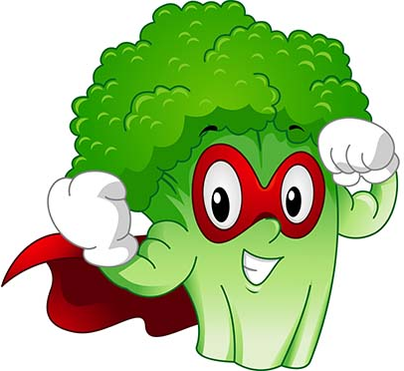
Objective
Develop lab experiments for a Molecular Nutrition Course
Test different foods/supplements for nutritional info
Investigate health properties of different types of diets
Investigate the claims about raved “superfoods”

Slide 4
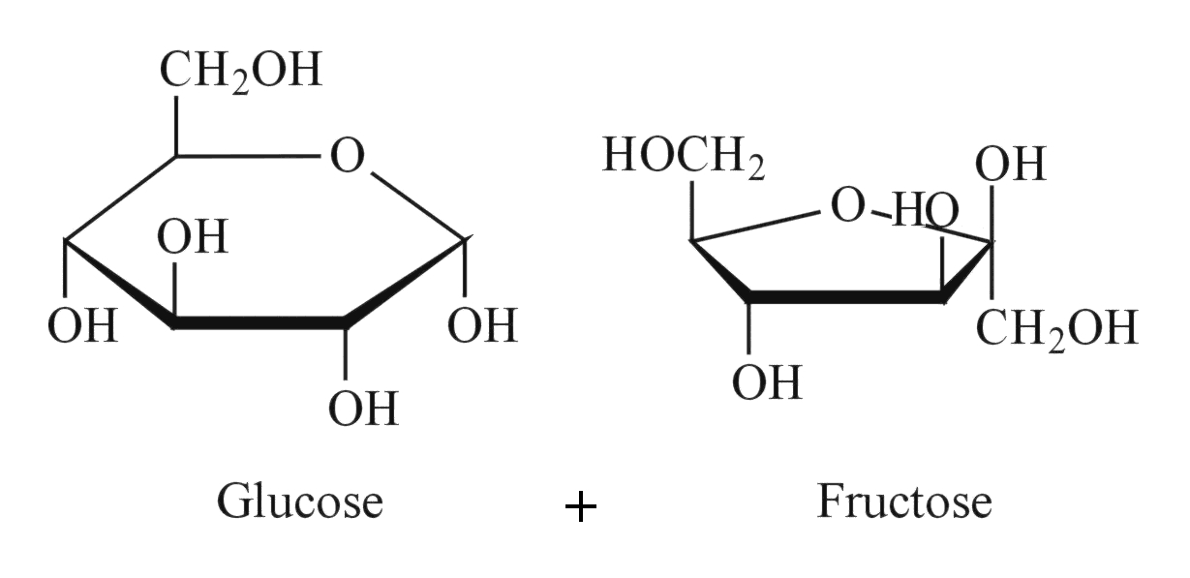
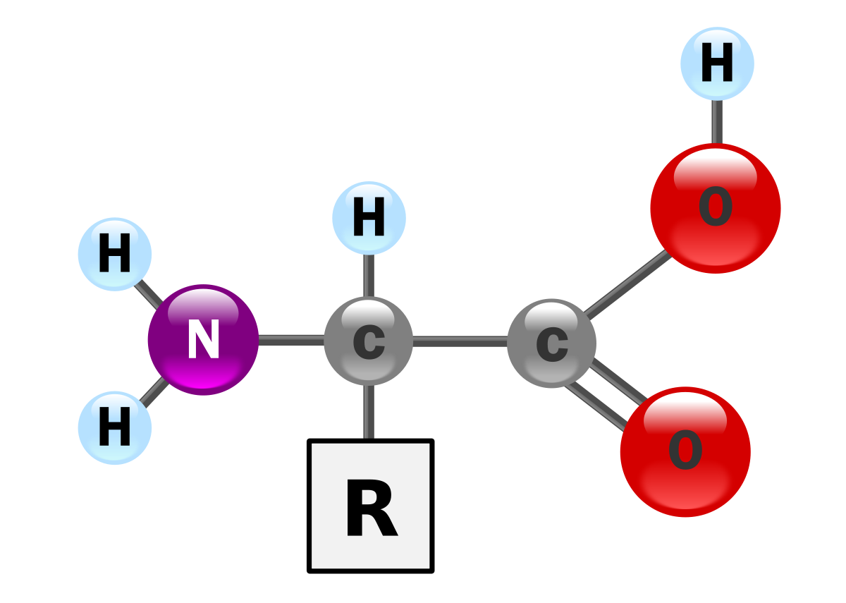
Background Information
Macro/micronutrients
Carbohydrates
Amino Acids
Vitamins
Minerals

Slide 5
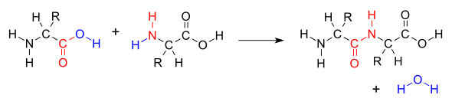
Amino Acids
Essential vs. Nonessential
20 common amino acids
9 of 20 are essential

Slide 6
Expected Positive Result:
blue/violet coloration
Expected Positive Result:
red coloration
Amino Acid Tests
Histidine Test
detection of histidine
Folin’s McCarthy Sullivan Test
detection of methionine

Slide 7
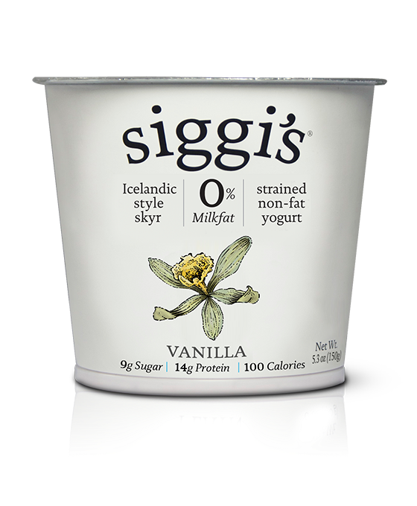
Substances Tested
Lentils
Rice
Quinoa
Hemp
Chia
Flax Seed
Icelandic Yogurt
Peanut Butter
Almond Butter

Slide 8
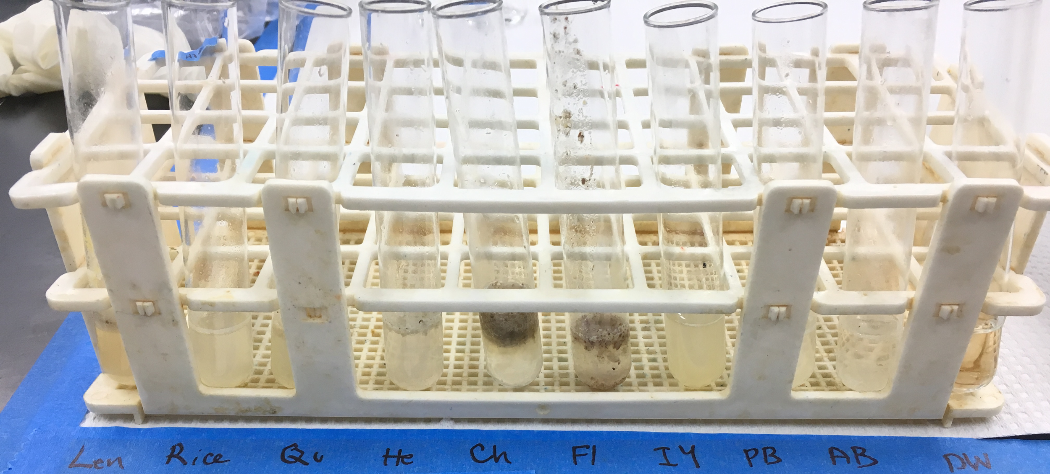
Histidine Test Results

Slide 9
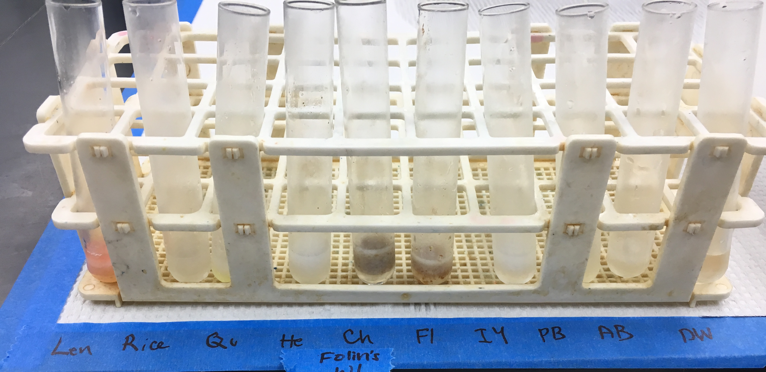
Folin’s McCarthy Test Results

Slide 10
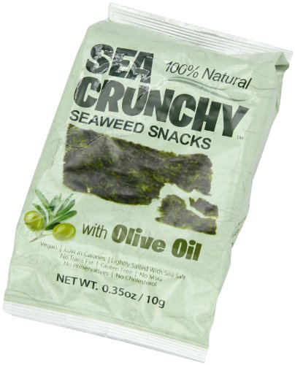
Seaweed Solvents
Seaweed Tested
Sea Crunchy Seaweed Snack
Arame
Solvents Tested
PH 7 Buffer
Acetone
Ethanol

Slide 11
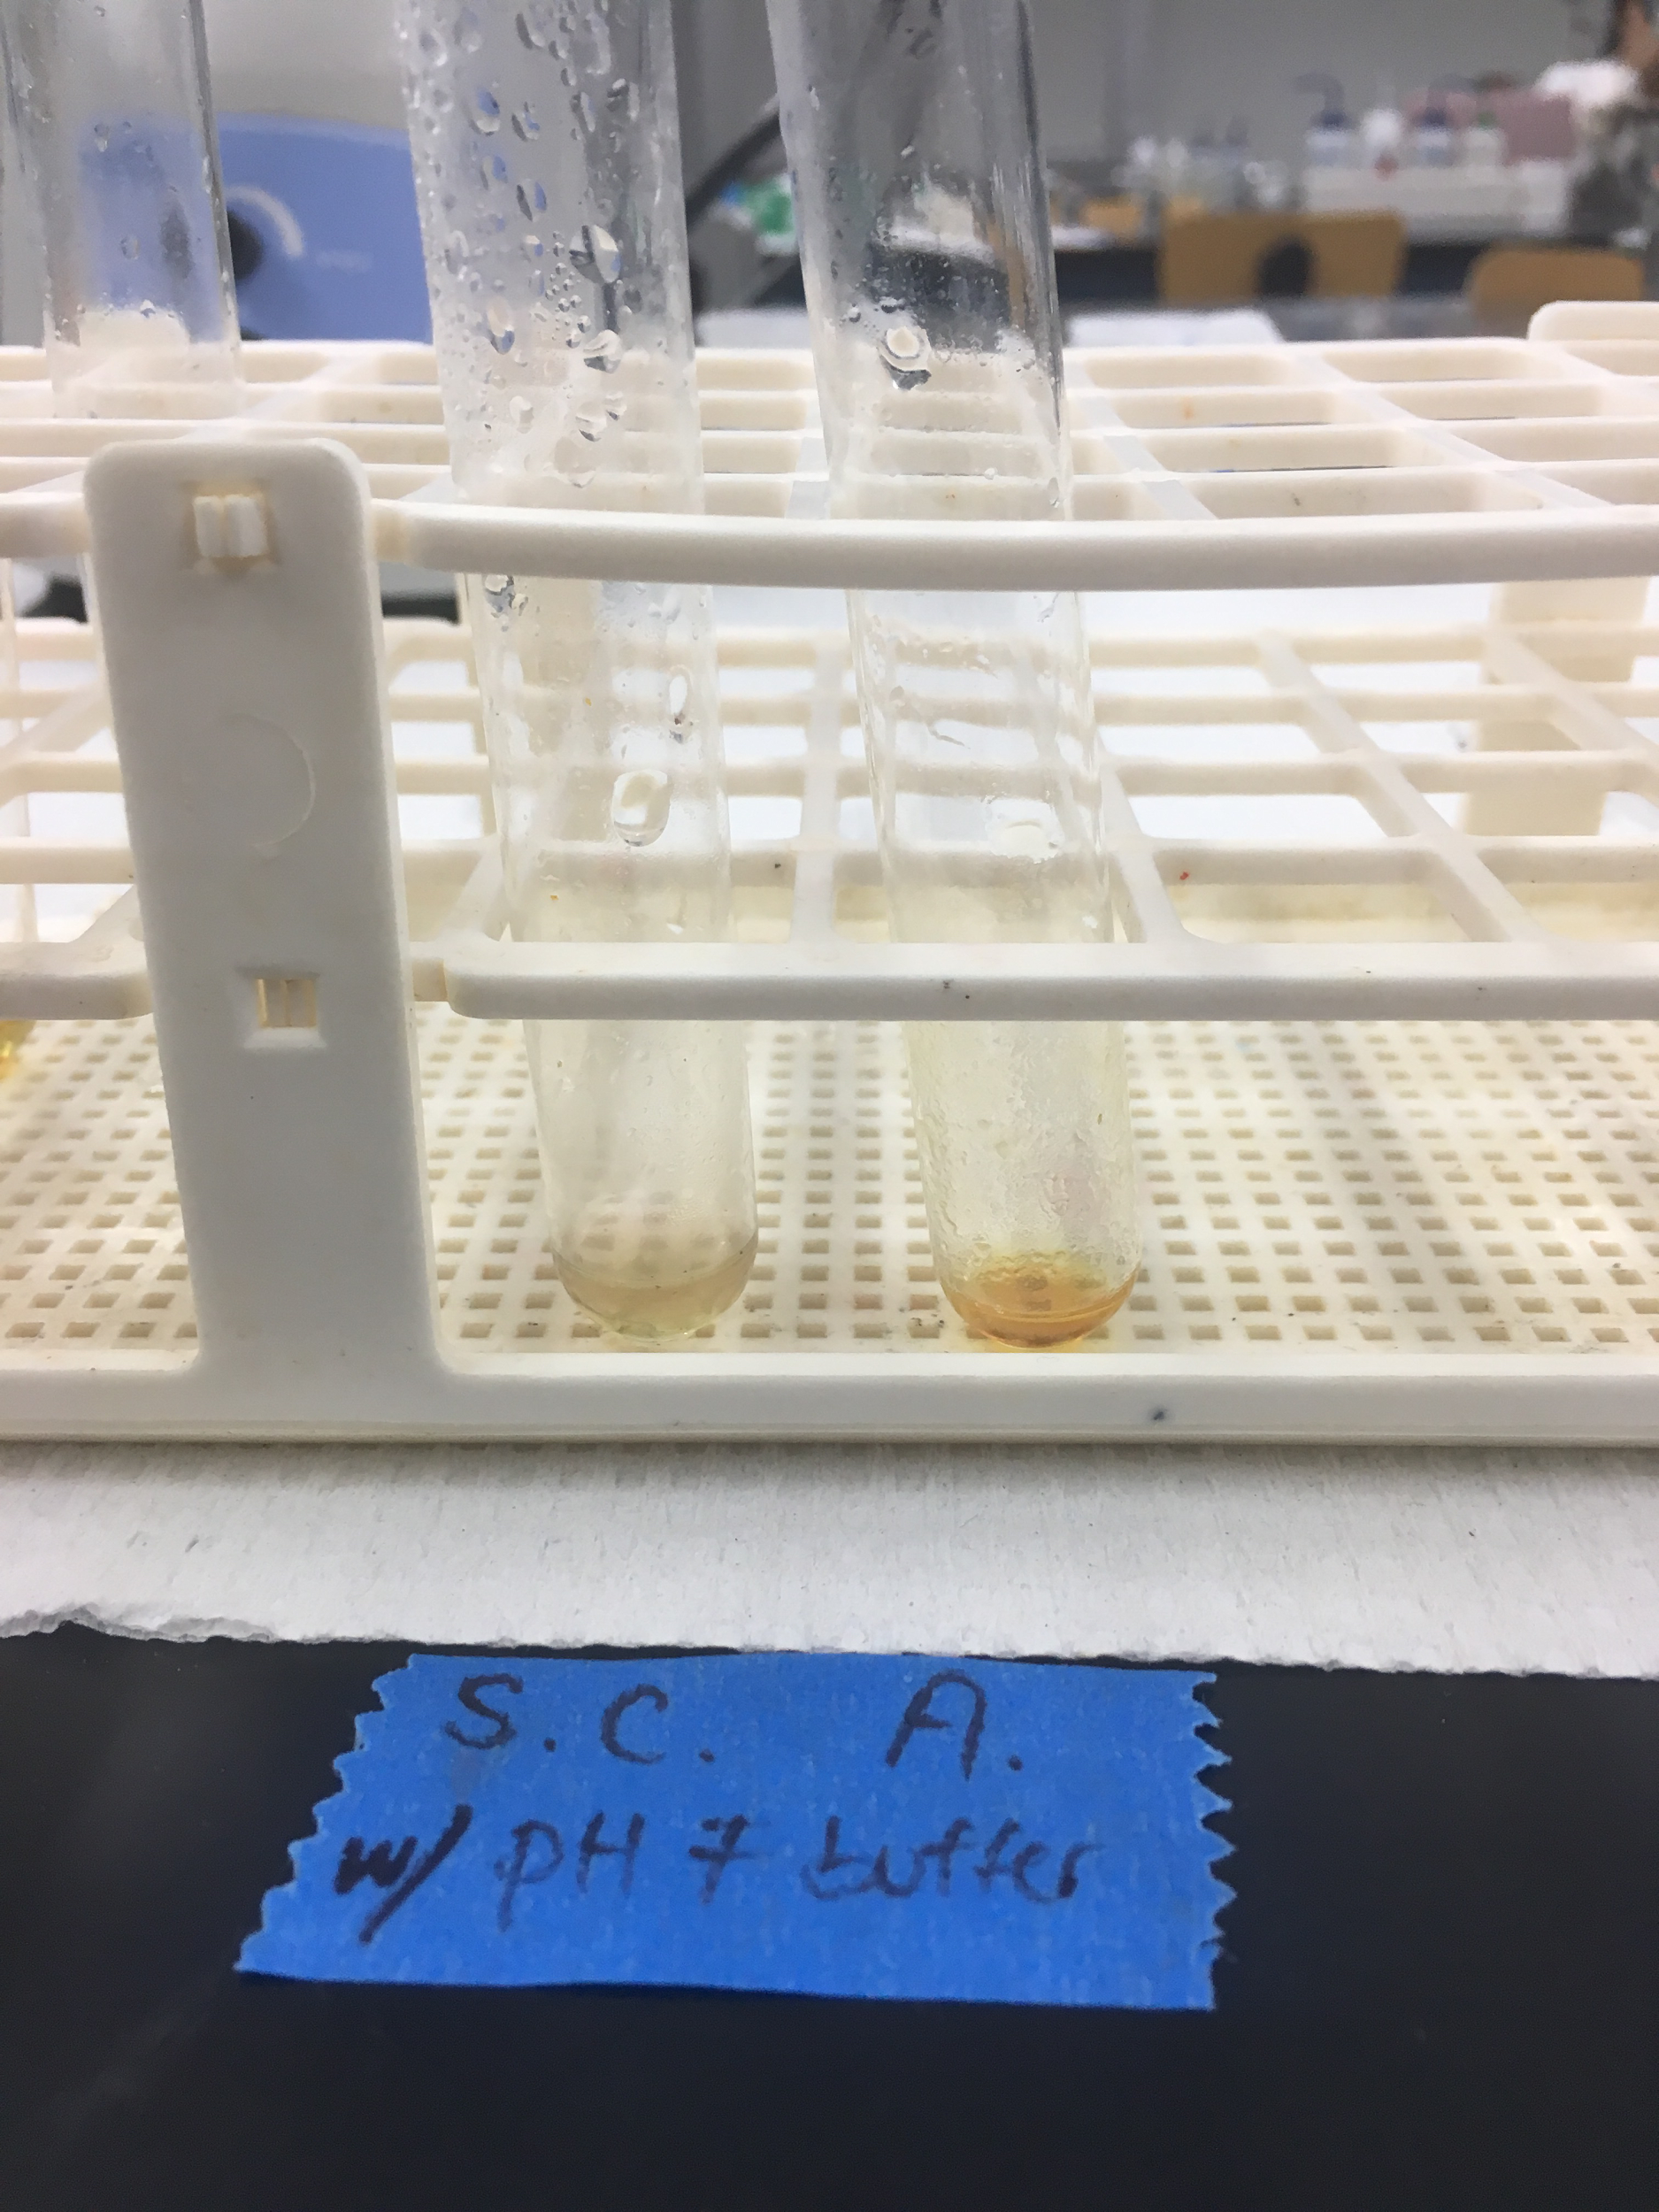
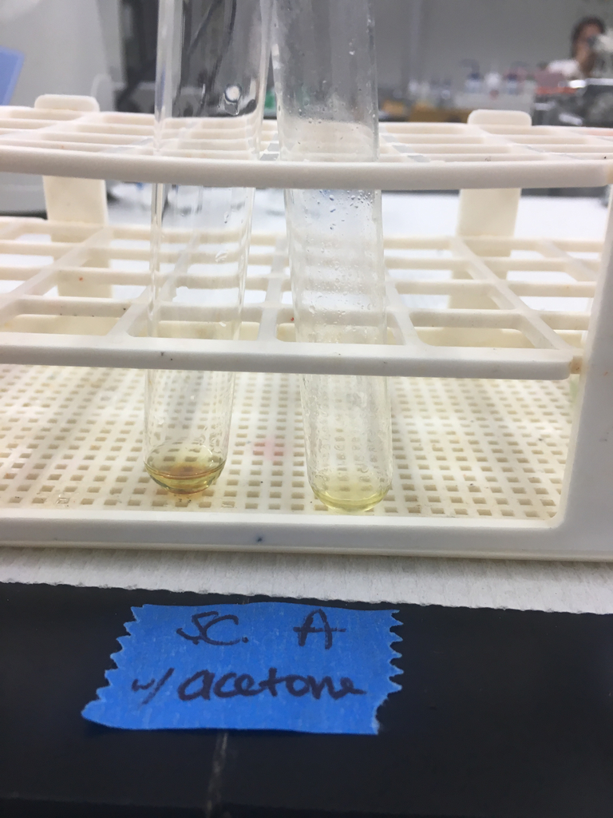
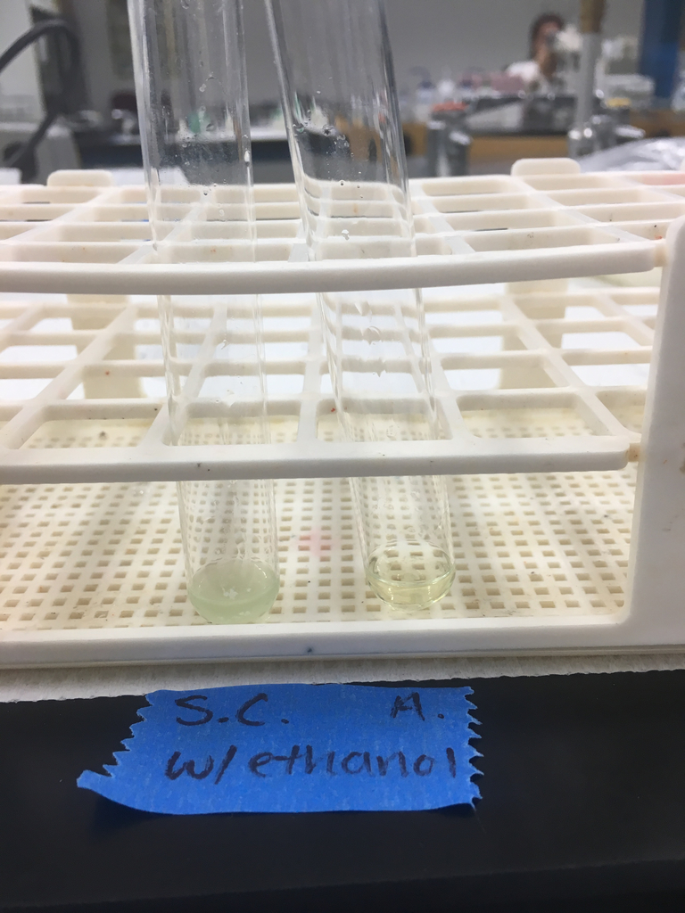
Solvent Results

Slide 12
Solvent Results
Solvent | Sea Crunchy | Arame
PH 7 | negative | positive
Acetone | Positive (caught on fire) | positive
Ethanol | Negative (caught on fire) | negative

Slide 13
Improvements
Uniformity in lab experiments: Repeatability
Use of different solvents/dilutions
Prep time has improved significantly
Organization of results

Slide 14
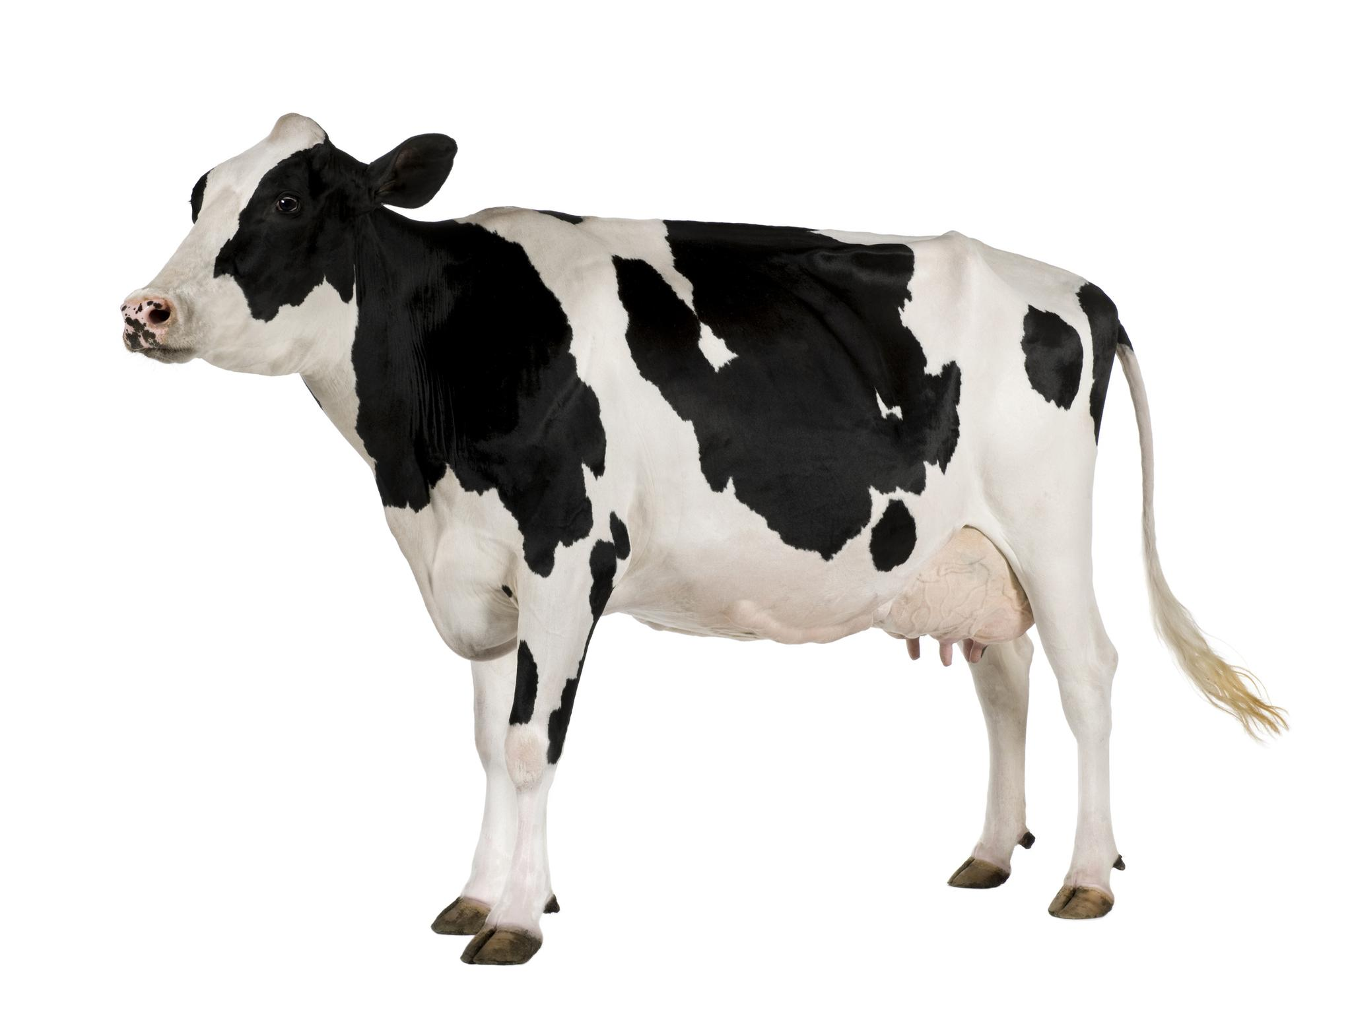
Further Research Tasks
Solidify a positive control for different
amino acid tests
Investigate chemical mechanisms of
tests to improve substance preparation
Incorporate other forms of nutrient ID (IR, Mass Spec,etc.)

